Slide 1

WSQ
FINANCIAL ANALYSIS
COURSE SLIDES · WSQ
Financial Analysis for Small and Medium Enterprises
WSQ Course Code: TGS-2026064860
Conducted by Tertiary Infotech Academy Pte Ltd · UEN 201200696W
Version v13 · 11 August 2026
© 2026 Tertiary Infotech Academy Pte Ltd. All rights reserved. · www.tertiarycourses.com.sg

Slide 2
COURSE ADMINISTRATION
Welcome & Housekeeping
Financial Analysis for Small and Medium Enterprises · TGS-2026064860
© 2026 Tertiary Infotech Academy Pte Ltd
1

Slide 3
TRAQOM · SSG DIGITAL ATTENDANCE
Digital Attendance (Mandatory)
• It is mandatory to take the AM, PM and Assessment digital attendance for WSQ-funded courses.
• The trainer or administrator will show you the digital attendance QR code generated from the SSG portal.
• Scan the QR code with your mobile phone camera and submit your attendance.
• A minimum of 75% attendance is required to be eligible for assessment and funding.
Financial Analysis for Small and Medium Enterprises · TGS-2026064860
© 2026 Tertiary Infotech Academy Pte Ltd
2

Slide 4
YOUR TRAINER · GENERAL
About the Trainer
NAME
____________________________________________
?
TITLE / DESIGNATION
____________________________________________
QUALIFICATIONS
____________________________________________
Your Trainer
AREAS OF EXPERTISE
____________________________________________
General Trainer template — to be completed by the trainer
TRAINING & INDUSTRY EXPERIENCE
____________________________________________
CONTACT
____________________________________________
Financial Analysis for Small and Medium Enterprises · TGS-2026064860
© 2026 Tertiary Infotech Academy Pte Ltd
3

Slide 5
YOUR TRAINER
About the Trainer
ROLE
Principal Trainer, Tertiary Infotech Academy Pte Ltd
AA
BACKGROUND
PhD; ACTA/ACLP-certified trainer with deep experience in data analytics, finance and business applications.
Dr Alfred Ang
DELIVERS
WSQ courses on financial analysis, accounting systems, data analytics and business software.
Principal Trainer Tertiary Infotech Academy Pte Ltd
FOUNDER
Founder and lead instructor at Tertiary Infotech / Tertiary Courses.
Financial Analysis for Small and Medium Enterprises · TGS-2026064860
© 2026 Tertiary Infotech Academy Pte Ltd
4

Slide 6
ICE-BREAKER
Let's Know Each Other
• Your name and organisation / role.
• Your experience with accounting or finance (if any).
• What you want to be able to analyse or decide after this course.
Financial Analysis for Small and Medium Enterprises · TGS-2026064860
© 2026 Tertiary Infotech Academy Pte Ltd
5

Slide 7
HOUSEKEEPING
Ground Rules
Set your mobile phone to silent mode.
Participate actively — no question is stupid.
1
2
Mutual respect: agree to disagree.
One conversation at one time.
3
4
Be punctual; return from breaks on time.
75% attendance is required.
5
6
Financial Analysis for Small and Medium Enterprises · TGS-2026064860
© 2026 Tertiary Infotech Academy Pte Ltd
6

Slide 8

LMS / TMS COURSE PORTAL
Download Course Material
• Go to https://lms-tms.tertiaryinfotech.com
• Log in with your registered email — an OTP is sent to you.
• Open your course: Financial Analysis for Small and Medium Enterprises
• Download the slides, Learner Guide and activity worksheets.
• Keep them handy — the final assessment is open book.
Financial Analysis for Small and Medium Enterprises · TGS-2026064860
© 2026 Tertiary Infotech Academy Pte Ltd
7

Slide 9
SCHEDULE
Lesson Plan — 2 Days, 8 Hours/Day
Day 1
Day 2
• Day 1 — Financial Statements & Financial Ratios
– Digital Attendance (AM)
– Trainer and learner introductions · Learning outcomes · Course outline
– Topic 1: Understanding Financial Statements (Activity 1)
– Lunch break · Digital Attendance (PM)
– Topic 2: Analysing Financial Ratios (Activities 2–3)
• Day 2 — Planning, Budgeting & Final Assessment
– Digital Attendance (AM)
– Topic 3: Planning & Budgeting using Financial Statements (Activities 4–6)
– Lunch break · Digital Attendance (PM)
– Revision · Course feedback & TRAQOM survey
– Digital Attendance (Assessment) · Final Assessment (WA + PP)
Financial Analysis for Small and Medium Enterprises · TGS-2026064860
© 2026 Tertiary Infotech Academy Pte Ltd
8

Slide 10
WSQ SKILLS FRAMEWORK
Skills Framework (TSC)
TSC Title · Code
Financial Analysis · ACC-MAC-5004-1.1
Knowledge K1–K2
Statement of financial position · Balance sheet
1
2
Knowledge K3–K4
Income and cash flow statements · Statement of changes in equity
Knowledge K5
Financial statement analysis techniques
3
4
Ability A1
Identify trends by comparing ratios across time periods and statement types
Ability A2
Prepare and interpret performance and position using financial statements
5
6
Financial Analysis for Small and Medium Enterprises · TGS-2026064860
© 2026 Tertiary Infotech Academy Pte Ltd
9

Slide 11
WHAT YOU'LL ACHIEVE
Learning Outcomes
LO1 — Understand
Financial statements: the balance sheet, income statement and cash flow statement.
1
LO2 — Evaluate
The organisation's financial performance from the trend of financial ratios.
2
LO3 — Analyze
Financial statements and prepare the organisation's position.
3
Financial Analysis for Small and Medium Enterprises · TGS-2026064860
© 2026 Tertiary Infotech Academy Pte Ltd
10

Slide 12
COURSE OUTLINE
Course Outline — 3 Topics
Topic 1 (K1–K3)
Topic 2 (K4, A1)
Topic 3 (K5, A2)
• Overview of Finance and Chart of Accounts
• Balance Sheet Statement
• Profit and Loss (P&L) Statement
• Cash Flow Statement
• Ratios for Corporate Profitability
• Ratios for Corporate Performance
• Equity Changes Statement
• Analyse Financial Statements
• Financial Planning
• Capital Budgeting
Financial Analysis for Small and Medium Enterprises · TGS-2026064860
© 2026 Tertiary Infotech Academy Pte Ltd
11

Slide 13
WSQ FUNDING
Criteria for Funding
• Minimum attendance rate of 75% based on the SSG Digital Attendance record.
• Complete the assessment and be assessed as 'Competent'.
Financial Analysis for Small and Medium Enterprises · TGS-2026064860
© 2026 Tertiary Infotech Academy Pte Ltd
12

Slide 14
Briefing for Assessment
• Place phones and other materials under the table or on the floor.
• No photos or recording of assessment scripts.
• No discussion during the assessment.
• Use a black/blue pen for hard-copy assessments.
• No liquid paper or correction tape.
• Assessment scripts are collected when the time is up.
Financial Analysis for Small and Medium Enterprises · TGS-2026064860
© 2026 Tertiary Infotech Academy Pte Ltd
13

Slide 15
FINAL ASSESSMENT
Assessment
• Written Assessment (WA) — Short-Answer Questions (SAQ), 1 hour, open book.
• Practical Performance (PP) — financial-analysis tasks on real statements, 1 hour, open book.
• Format: Open Book — slides, Learner Guide and approved materials only.
• A minimum of 75% attendance is required to be eligible for assessment and funding.
• An appeal process is available if required.
Financial Analysis for Small and Medium Enterprises · TGS-2026064860
© 2026 Tertiary Infotech Academy Pte Ltd
14

Slide 16
ON ASSESSMENT DAY
Assessment Flow
1
2
3
4
5
▶
▶
▶
▶
TRAQOM survey — scan the QR code on the LMS
Assessment digital attendance — scan the SSG QR
Sit WA (SAQ) then PP — open book
Submit your answers on the LMS
Sign the Assessment Summary Record
Financial Analysis for Small and Medium Enterprises · TGS-2026064860
© 2026 Tertiary Infotech Academy Pte Ltd
15

Slide 17
01
TOPIC 01
Understanding Financial Statements
Overview of Finance and Chart of Accounts · Balance Sheet Statement · Profit and Loss (P&L) Statement · Cash Flow Statement
Financial Analysis for Small and Medium Enterprises · TGS-2026064860
© 2026 Tertiary Infotech Academy Pte Ltd
16

Slide 18
TSC K1 · K2 · K3
Key Concepts — Understanding Financial Statements
Finance & accounting
Why finance matters to every business decision — the language of the boardroom.
Chart of accounts
The general-ledger account structure that every transaction is recorded against.
1
2
Balance sheet
Assets = Liabilities + Equity — the statement of financial position at a point in time.
Income statement
Revenue − Expenses = Profit — financial performance over an accounting period.
3
4
Cash flow statement
Operating, investing and financing cash movements — where the cash actually went.
Double-entry system
Debits equal credits, so the accounting equation always balances.
5
6
Financial Analysis for Small and Medium Enterprises · TGS-2026064860
© 2026 Tertiary Infotech Academy Pte Ltd
17

Slide 19
BUSINESS FINANCE
Finance is attaining money, investing it, and gaining a return on investment.
Any business decision has financial impact — finance is the common language of the boardroom.
Financial Analysis for Small and Medium Enterprises · TGS-2026064860
© 2026 Tertiary Infotech Academy Pte Ltd
18

Slide 20
WHY FINANCE MATTERS
Significance of Finance
Any business decision has financial impact.
It is the common language used in board meetings.
1
2
The more you understand finance, the more the insights.
Dealing with finance people becomes easy.
3
4
Relate finance to your own business unit.
Drive and achieve better performance.
5
6
Financial Analysis for Small and Medium Enterprises · TGS-2026064860
© 2026 Tertiary Infotech Academy Pte Ltd
19

Slide 21
CORPORATE ORG STRUCTURE · FINANCE
The Finance Business Unit
FP&A
Budgeting, forecasting, actual vs variance, management reports.
Operations
Purchases and payables · expenses · sales and receivables.
1
2
Controls
Internal controls, audit, processes and policies.
Systems
Finance tools, transformation, ERP implementation, data & BI.
3
4
M&A
Due diligence, checklists, M&A budget, pre/post-integration.
Tax & Treasury
Corporate tax, GST, tax audit and cash flow management.
5
6
Financial Analysis for Small and Medium Enterprises · TGS-2026064860
© 2026 Tertiary Infotech Academy Pte Ltd
20

Slide 22
LENDERS ↔ BORROWERS
The Financial System
Lenders & regulators
Borrowers
• Regulators & institutions
– Ministry of Finance · ACRA · IRAS · SAC · CPF
– Banks · insurance companies · mutual funds · private equity funds
– Lenders provide capital to the system
• Borrowers & businesses
– Sole proprietorship · partnership / LLP
– Private company · public listed company
– Non-profit organisations · individuals · foreign companies
Financial Analysis for Small and Medium Enterprises · TGS-2026064860
© 2026 Tertiary Infotech Academy Pte Ltd
21

Slide 23
ACCOUNTING
Accounting — the Big Picture
Three questions
How much money do I need? How do I raise it? How do I manage it?
The equation
Assets = Liabilities + Owner's Equity — always in balance.
1
2
The mechanics
Double entry · transaction analysis · summary of transactions.
The outputs
Income statement · owner's equity statement · balance sheet · statement of cash flows.
3
4
Financial Analysis for Small and Medium Enterprises · TGS-2026064860
© 2026 Tertiary Infotech Academy Pte Ltd
22

Slide 24
WHY WE ACCOUNT
Objectives & Advantages of Accounting
Objectives
Advantages
• Objectives
– Maintain a systematic record of transactions
– Ascertain profit or loss and financial position
– Assist management and communicate information to users
– Prevent manipulation and fraud
• Advantages
– Financial information about the business; replaces memory
– Facilitates benchmarking, tax settlement and loans
– Evidence in court; facilitates sale of the business
– Helps in decision making
Financial Analysis for Small and Medium Enterprises · TGS-2026064860
© 2026 Tertiary Infotech Academy Pte Ltd
23

Slide 25
ACCOUNTING TYPES
Types of Accounting
Financial accounting
Aggregates financial information into external reports — IFRS, GAAP.
Management accounting
Internal operational reporting — cost accounting, payroll, payables.
1
2
Tax accounting
Compliance with tax regulations, filings and future tax planning.
Auditing
Assurance that financial statements fairly present results and position.
3
4
Forensic accounting
Reconstruction of financial information when records are incomplete.
Internal auditing
Examination of systems and transactions to spot weaknesses, fraud and waste.
5
6
Financial Analysis for Small and Medium Enterprises · TGS-2026064860
© 2026 Tertiary Infotech Academy Pte Ltd
24

Slide 26
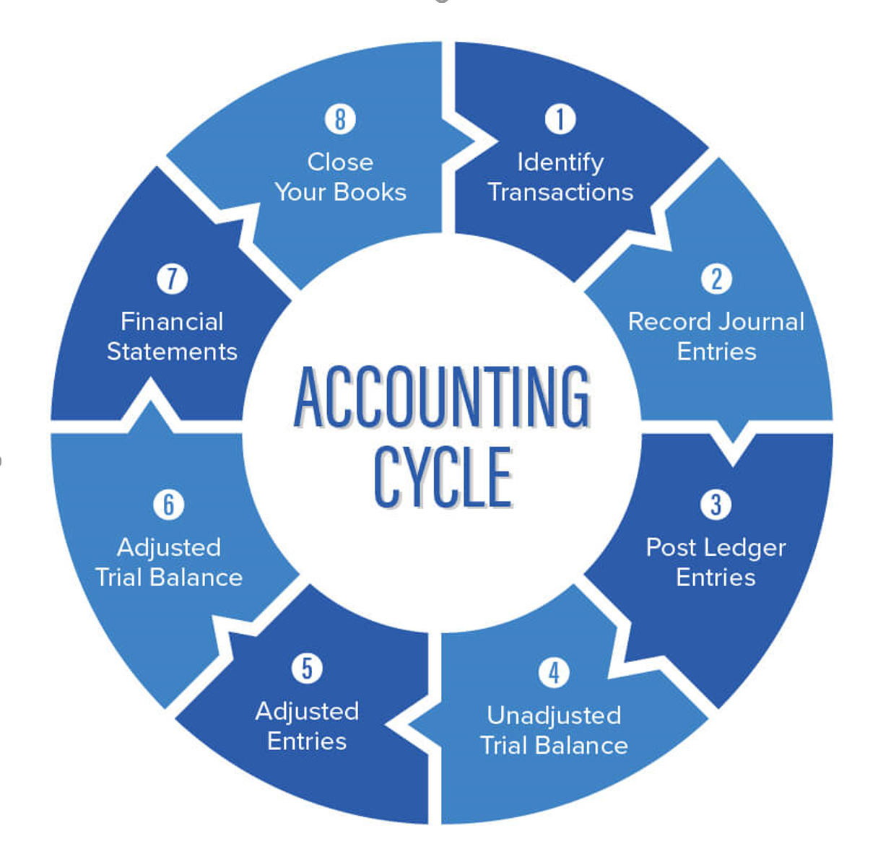
FROM TRANSACTION TO STATEMENTS
The Accounting Cycle
Identify transactions → journal entries → ledger → trial balance → adjustments → financial statements → close.
Financial Analysis for Small and Medium Enterprises · TGS-2026064860
© 2026 Tertiary Infotech Academy Pte Ltd
25

Slide 27
TIMEFRAMES
Accounting Periods
• An accounting period is the time span for which financial statements are prepared — e.g. a calendar year, a quarter or a month.
• The income statement and cash flow statement report amounts occurring DURING the period.
• The balance sheet reports assets and liabilities AS AT the final moment of the period.
Financial Analysis for Small and Medium Enterprises · TGS-2026064860
© 2026 Tertiary Infotech Academy Pte Ltd
26

Slide 28
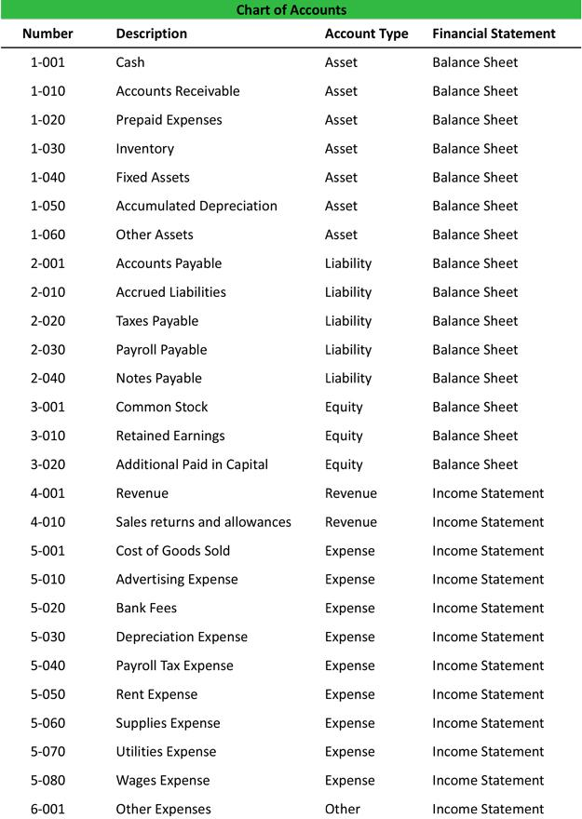
THE LEDGER STRUCTURE
Chart of Accounts
• A chart of accounts lists the account names a company uses to record transactions in its general ledger.
• Typical numbering: assets, liabilities, equity, revenue and expenses.
• Each account maps to either the balance sheet or the income statement.
• Companies tailor the chart to their needs and add accounts as required.
Financial Analysis for Small and Medium Enterprises · TGS-2026064860
© 2026 Tertiary Infotech Academy Pte Ltd
27

Slide 29
RECORDING SYSTEMS
Single-Entry vs Double-Entry Accounting
Single entry
Double entry
• Single entry
– One entry per transaction, centred on the income statement
– Tracks cash receipts and disbursements — the cash book
– Assets and liabilities are not tracked systematically
– Suitable only for the simplest businesses
• Double entry
– Every transaction hits at least two accounts
– Debits always equal credits
– The accounting equation stays in balance
– The standard for every modern accounting system
Financial Analysis for Small and Medium Enterprises · TGS-2026064860
© 2026 Tertiary Infotech Academy Pte Ltd
28

Slide 30
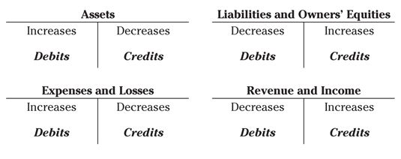
WHICH SIDE INCREASES?
Double-Entry Rules — Debits & Credits
Assets and expenses increase with debits; liabilities, equity and revenue increase with credits.
Financial Analysis for Small and Medium Enterprises · TGS-2026064860
© 2026 Tertiary Infotech Academy Pte Ltd
29

Slide 31
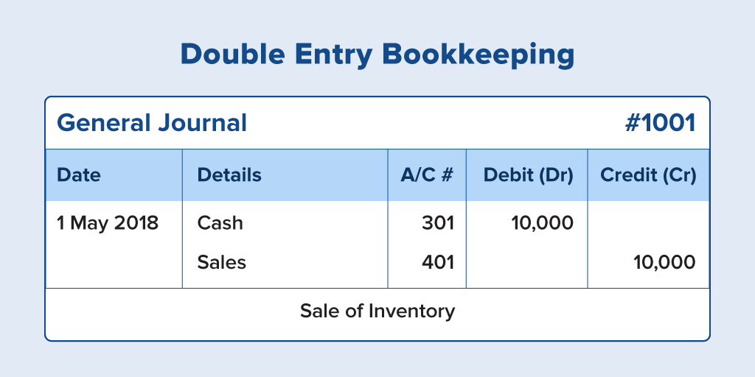
GENERAL JOURNAL
Double-Entry Bookkeeping — Journal Example
A $10,000 cash sale: debit Cash (A/C 301), credit Sales (A/C 401).
Financial Analysis for Small and Medium Enterprises · TGS-2026064860
© 2026 Tertiary Infotech Academy Pte Ltd
30

Slide 32
THE RECORDING DISCIPLINE
Bookkeeping
• Bookkeeping is the systematic gathering and recording of a company's financial transactions.
• Transactions are identified, approved, sorted and stored so they can be retrieved and presented in reports.
• Examples: purchase of supplies with cash · purchase/sale of merchandise on credit · rent · salaries and wages · buying equipment · borrowing from a bank.
Financial Analysis for Small and Medium Enterprises · TGS-2026064860
© 2026 Tertiary Infotech Academy Pte Ltd
31

Slide 33
FINANCIAL REPORTS
The Three Key Financial Statements
Balance Sheet
Income Statement
Cash Flow Statement
• Statement of financial position
• Assets = Liabilities + Equity
• Liquidity and net worth
• A snapshot AS AT a date
• Profit & Loss statement
• Profits = Revenues − Expenses
• Profitability over a period
• Top line to bottom line
• Movement of cash in the business
• Operating · investing · financing
• Where cash came from and went
• Reconciles to the cash balance
Financial Analysis for Small and Medium Enterprises · TGS-2026064860
© 2026 Tertiary Infotech Academy Pte Ltd
32

Slide 34
WHO READS THE NUMBERS
Users of Financial Statements
Management
Run the business — plans, budgets and performance reviews.
Investors & owners
Assess returns, growth and the safety of their capital.
1
2
Lenders & creditors
Judge the ability to repay loans and trade credit.
Regulators & tax authorities
Compliance — ACRA filings, IRAS tax computations.
3
4
Suppliers & customers
Decide whether to extend credit or rely on the firm.
Employees
Job security, bonuses and profit-sharing.
5
6
Financial Analysis for Small and Medium Enterprises · TGS-2026064860
© 2026 Tertiary Infotech Academy Pte Ltd
33

Slide 35
BALANCE SHEET · THE FUNDAMENTAL EQUATION
Assets = Liabilities + Owners' Equity
The balance sheet shows what the business owns (utilisation of funds) against what it owes and what the owners put in (sources of funds).
Financial Analysis for Small and Medium Enterprises · TGS-2026064860
© 2026 Tertiary Infotech Academy Pte Ltd
34

Slide 36
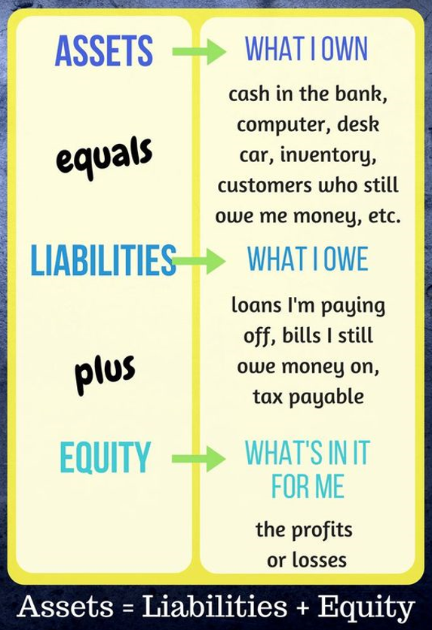
ASSETS = LIABILITIES + EQUITY
The Accounting Equation
Assets are what I own; liabilities are what I owe; equity is what is left for the owners.
Financial Analysis for Small and Medium Enterprises · TGS-2026064860
© 2026 Tertiary Infotech Academy Pte Ltd
35

Slide 37
THE BUILDING BLOCKS
Balance Sheet — Definitions
Assets
Resources that will provide a benefit in the future — utilisation of funds.
Liabilities
Obligations to repay money or provide a service in the future.
1
2
Owners' Equity
Money provided to the company by the owners.
Retained Earnings
Net income that is re-invested in the business.
3
4
Financial Analysis for Small and Medium Enterprises · TGS-2026064860
© 2026 Tertiary Infotech Academy Pte Ltd
36

Slide 38
STRUCTURE
Balance Sheet Components
Assets
Liabilities & Equity
• Assets
– Current assets: cash & equivalents, receivables, inventories, marketable securities
– Long-term assets: plant, property & equipment (PP&E), intangible assets
• Liabilities & Equity
– Current liabilities: accounts payable, current debt, current portion of LT debt
– Long-term liabilities: bonds payable, long-term debt
– Shareholders' equity: share capital + retained earnings
Financial Analysis for Small and Medium Enterprises · TGS-2026064860
© 2026 Tertiary Infotech Academy Pte Ltd
37

Slide 39
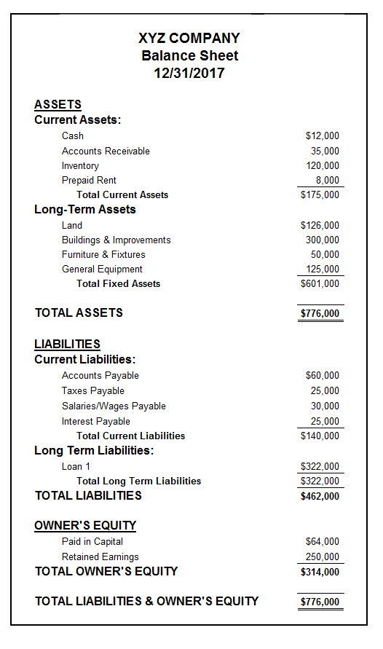
XYZ COMPANY
Balance Sheet — Example
Current and long-term assets vs current and long-term liabilities and owners' equity.
Financial Analysis for Small and Medium Enterprises · TGS-2026064860
© 2026 Tertiary Infotech Academy Pte Ltd
38

Slide 40
READ WITH CARE
Balance Sheet — Limitations
• The balance sheet is a static document — it depicts assets and liabilities 'as on date X' only.
• Assets are expressed at book value (historic cost less depreciation), which may differ from market value.
• Not all assets appear — e.g. internally-generated intangibles such as patents and a skilled workforce.
Financial Analysis for Small and Medium Enterprises · TGS-2026064860
© 2026 Tertiary Infotech Academy Pte Ltd
39

Slide 41
LIQUID · QUICK TO CONVERT TO CASH
Current Assets
Cash & equivalents
Legal tender, bills, coins, cheques; banker's acceptances, commercial paper, securities maturing < 90 days.
Accounts receivable
Funds owed by customers — recorded once goods or services are delivered.
1
2
Inventories
Raw materials, work-in-progress and finished goods held for sale.
Marketable securities
Common stock, treasury bills and bonds maturing within one year.
3
4
Financial Analysis for Small and Medium Enterprises · TGS-2026064860
© 2026 Tertiary Infotech Academy Pte Ltd
40

Slide 42
NON-CURRENT ASSETS
Long-Term Assets
PP&E
Plant, property and equipment — the tangible productive base of the business.
Depreciation
Spreads the asset's cost over time to match the income it produces; the method chosen affects results.
1
2
Intangible assets
Patents, trademarks, goodwill — non-physical assets with economic value.
Working capital
Current assets − current liabilities: the funds available to run daily operations.
3
4
Financial Analysis for Small and Medium Enterprises · TGS-2026064860
© 2026 Tertiary Infotech Academy Pte Ltd
41

Slide 43
DEPRECIATION OF PP&E
Four Depreciation Methods
Straight line
(Cost − Salvage) / Useful life
$50,000 over 10 years → $5,000/yr
Double declining
2 × SL rate × Book value
Higher expense in early years
Units of production
(Units / Life units) × (Cost − Salvage)
3M of 100M units on $50,000 → $1,500
Sum of years
(Remaining life / SYD) × (Cost − Salvage)
$25,000, 8 yrs → yr 1 $5,556, yr 2 $4,861
Financial Analysis for Small and Medium Enterprises · TGS-2026064860
© 2026 Tertiary Infotech Academy Pte Ltd
42

Slide 44
OBLIGATIONS
Liabilities
Current (< 1 year)
Long-term (> 1 year)
• Current liabilities
– Accounts payable — money owed to vendors and suppliers
– Current debt / notes payable — borrowings payable within one year
– Current portion of long-term debt accrued this operating cycle
• Long-term liabilities
– Bonds payable — principal at a future date, periodic interest
– Bond types: serial, sinking fund, convertible, registered, secured, debenture
– Long-term debt — owed to creditors beyond 12 months
Financial Analysis for Small and Medium Enterprises · TGS-2026064860
© 2026 Tertiary Infotech Academy Pte Ltd
43

Slide 45
THE OWNERS' STAKE
Shareholders' Equity
Share capital
Money invested by the owners — common or preferred shares.
Capital stages
Authorized → issued → subscribed → called-up → paid-up capital.
1
2
Retained earnings
Net profits kept in the company after all dividends and distributions.
Private equity
Ownership interest in a private company.
3
4
Financial Analysis for Small and Medium Enterprises · TGS-2026064860
© 2026 Tertiary Infotech Academy Pte Ltd
44

Slide 46
INCOME STATEMENT · THE FUNDAMENTAL EQUATION
Profits = Revenues − Expenses
The income statement (Profit & Loss) shows financial performance across an accounting period, from the top line to the bottom line.
Financial Analysis for Small and Medium Enterprises · TGS-2026064860
© 2026 Tertiary Infotech Academy Pte Ltd
45

Slide 47
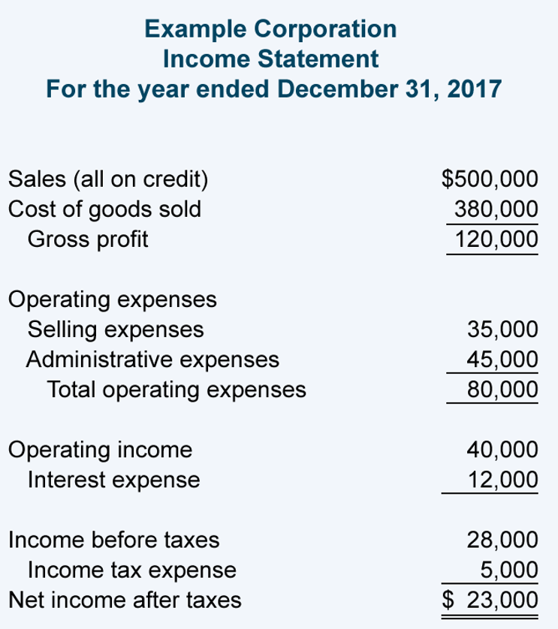
FROM TOP LINE TO BOTTOM LINE
Income Statement — Structure
• Revenue — the total of all sales (top line)
– − Cost of Goods Sold: direct materials, labour, overheads
• = Gross Profit
– − Operating expenses: rental, admin payroll, utilities
• = Operating Profit (EBIT)
– − Interest expenses on debt
• = Profit before Tax → − Tax = Profit after Tax
Financial Analysis for Small and Medium Enterprises · TGS-2026064860
© 2026 Tertiary Infotech Academy Pte Ltd
46

Slide 48
COMPONENTS
Income Statement — Key Terms
Revenue
Money actually received in the period, net of discounts and returns — the top line.
Expenses
Economic costs incurred to earn revenue; tax-deductible expenses lower taxable income.
1
2
EBITDA
Earnings before interest, tax, depreciation and amortization — operating performance without financing/accounting effects.
Depreciation & amortization
Wear-and-tear of tangible assets (depreciation) and write-down of intangibles (amortization).
3
4
Tax
A mandatory financial charge imposed by the government on income.
Net income
What remains for the owners after every expense — the bottom line.
5
6
Financial Analysis for Small and Medium Enterprises · TGS-2026064860
© 2026 Tertiary Infotech Academy Pte Ltd
47

Slide 49
THE PROFIT CASCADE
Summary of Income Statement Items
1
2
3
4
5
▶
▶
▶
▶
Revenue − COGS = Gross Profit
− Marketing, selling & admin = EBITDA
− Depreciation & amortization = EBIT
− Interest & other expenses = EBT
− Tax = Net Income
Financial Analysis for Small and Medium Enterprises · TGS-2026064860
© 2026 Tertiary Infotech Academy Pte Ltd
48

Slide 50
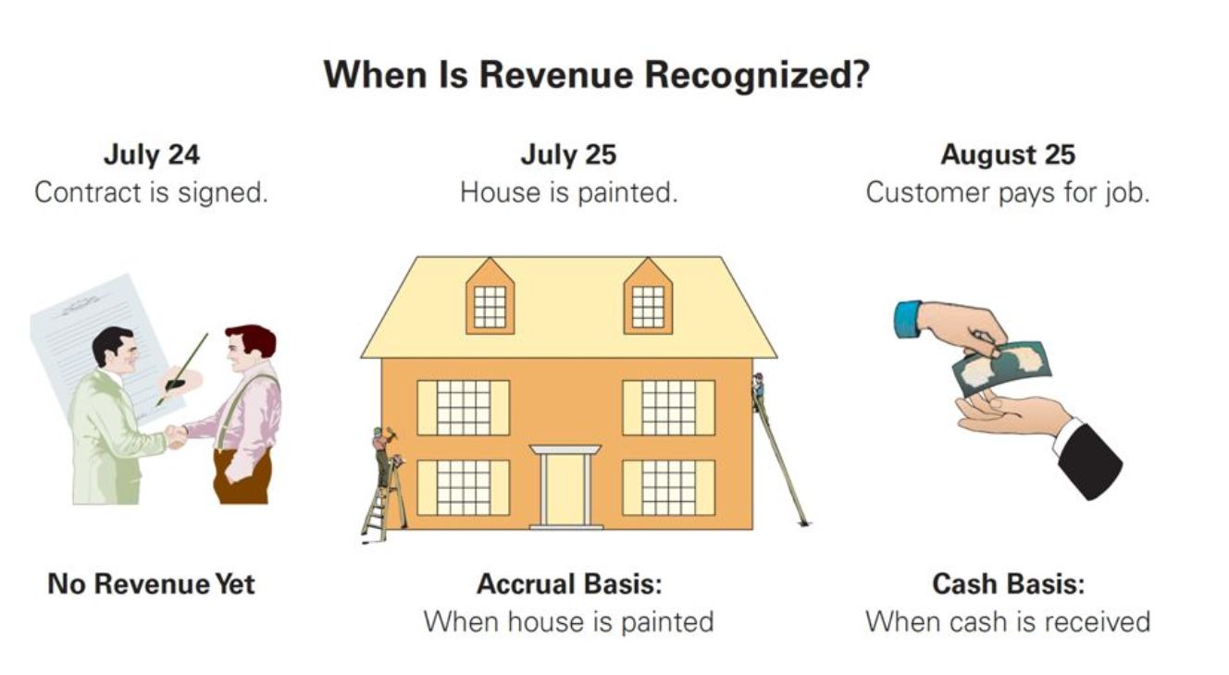
WHEN IS REVENUE RECOGNIZED?
Cash vs Accrual Basis Accounting
Accrual basis: recognise when the work is done. Cash basis: recognise when the cash is received.
Financial Analysis for Small and Medium Enterprises · TGS-2026064860
© 2026 Tertiary Infotech Academy Pte Ltd
49

Slide 51
FOLLOW THE CASH
Cash Flow Statement
What it shows
The movement of cash in the business — incoming and outgoing money.
Operating activities
Converts income-statement items from accrual to cash: sales income and production expenses.
1
2
Investing activities
Purchase and sale of long-term investments and PP&E — gains or losses on assets.
Financing activities
Issuance/repurchase of stock and bonds, loans and dividend payments.
3
4
Financial Analysis for Small and Medium Enterprises · TGS-2026064860
© 2026 Tertiary Infotech Academy Pte Ltd
50

Slide 52
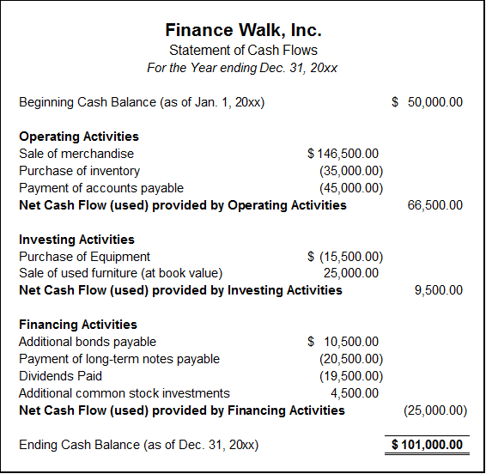
WORKED EXAMPLE
Cash Flow Statement — Example
Operating, investing and financing blocks reconcile the opening cash balance to the closing balance.
Financial Analysis for Small and Medium Enterprises · TGS-2026064860
© 2026 Tertiary Infotech Academy Pte Ltd
51

Slide 53
TOPIC 01 · HANDS-ON
Prepare a Cash Flow Statement
ACTIVITY 1
Havenwood Trading Pte Ltd is a fictitious Singapore SME distributor. From its FY2018/FY2019 balance sheets and FY2019 income statement (all in S$ million), derive the full statement of cash flows — operating, investing and financing — and reconcile it to the movement in cash.
You'll produce
A complete statement of cash flows (operating / investing / financing) for Havenwood Trading, derived from the balance sheet movements and the income statement.
Tools: Microsoft Excel · data workbook FA-Activity-01-Cash-Flow-Statement.xlsx in activities/activity01
All files: activities/activity01/ · Detailed step-by-step: see this activity in the Learner Guide.
Financial Analysis for Small and Medium Enterprises · TGS-2026064860
© 2026 Tertiary Infotech Academy Pte Ltd
52

Slide 54
TOPIC RECAP
Recap — Understanding Financial Statements
• The chart of accounts and double-entry rules keep the books in balance.
• The balance sheet shows position: Assets = Liabilities + Equity.
• The income statement shows performance: Profits = Revenues − Expenses.
• The cash flow statement shows where the cash actually moved.
• You prepared a full cash flow statement from a balance sheet and income statement.
Financial Analysis for Small and Medium Enterprises · TGS-2026064860
© 2026 Tertiary Infotech Academy Pte Ltd
53

Slide 55
02
TOPIC 02
Analysing Financial Ratios
Ratios for Corporate Profitability · Ratios for Corporate Performance · Equity Changes Statement
Financial Analysis for Small and Medium Enterprises · TGS-2026064860
© 2026 Tertiary Infotech Academy Pte Ltd
54

Slide 56
TSC K4 · A1
Key Concepts — Analysing Financial Ratios
Liquidity ratios
Current, quick, cash and operating-cash-flow ratios — can the firm pay its short-term bills?
Leverage ratios
Debt, debt-to-equity, interest coverage — how much risk is carried in the capital structure?
1
2
Efficiency ratios
Inventory, receivables, payables and asset turnover — how hard are the assets working?
Profitability ratios
Gross, operating, net margins, ROA, ROCE, ROE, EPS — is the business earning enough?
3
4
Equity changes statement
Reconciles opening to closing equity — share capital, dividends, retained earnings.
Trend analysis
Compare ratios across periods and statement types to spot direction and risk (A1).
5
6
Financial Analysis for Small and Medium Enterprises · TGS-2026064860
© 2026 Tertiary Infotech Academy Pte Ltd
55

Slide 57
THE ANALYST'S TOOLKIT
What is Financial Ratio Analysis?
• Financial ratios are mathematical indicators calculated by comparing key figures in the financial statements.
• They explain the reasons behind the current financial position and recent performance — and build expectations for the future.
• Example: net profit margin compares net income with net revenue — the dollars of profit earned per $100 of sales.
• Ratios only become meaningful against a benchmark: peers, the industry, or the company's own trend.
Financial Analysis for Small and Medium Enterprises · TGS-2026064860
© 2026 Tertiary Infotech Academy Pte Ltd
56

Slide 58
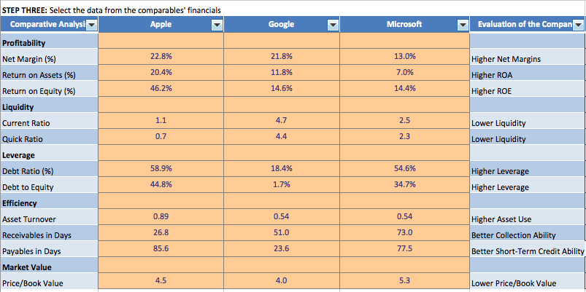
COMPARATIVE ANALYSIS
Identifying Relevant Data
Profitability, liquidity, leverage, efficiency and market-value ratios compared across companies.
Financial Analysis for Small and Medium Enterprises · TGS-2026064860
© 2026 Tertiary Infotech Academy Pte Ltd
57

Slide 59
WHY RATIOS
Benefits of Financial Ratios
Understand the profitability of the business.
Analyse operational efficiency.
1
2
Identify the liquidity of the business.
Identify business risks.
3
4
Identify financial risks.
Plan for the future.
5
6
Financial Analysis for Small and Medium Enterprises · TGS-2026064860
© 2026 Tertiary Infotech Academy Pte Ltd
58

Slide 60
RATIO MAP
The Four Ratio Families
Liquidity & Leverage
Efficiency
Profitability
• Current, quick, cash ratios
• Operating cash flow ratio
• Debt & debt-to-equity ratios
• Interest & debt service coverage
• Asset turnover
• Inventory turnover
• Receivables & payables turnover
• Collection & payment periods
• Gross / operating / net margins
• Return on assets & equity
• Return on capital employed
• Earnings per share
Financial Analysis for Small and Medium Enterprises · TGS-2026064860
© 2026 Tertiary Infotech Academy Pte Ltd
59

Slide 61
CAN THE FIRM PAY ITS BILLS?
Liquidity Ratios
Current Ratio
Current Assets / Current Liabilities
≥ 1 means current assets cover current bills
Quick (Acid Test) Ratio
(Cash + Securities + Receivables) / CL
Most readily available assets only
Cash Ratio
(Cash + Cash Equivalents) / CL
Normal value is below 1.00
Operating Cash Flow Ratio
Operating Cash Flow / CL
Cash generated vs short-term obligations
Financial Analysis for Small and Medium Enterprises · TGS-2026064860
© 2026 Tertiary Infotech Academy Pte Ltd
60

Slide 62
INTERPRETATION
Reading the Liquidity Ratios
• Current ratio ≥ 1: current assets exceed current liabilities — no expected liquidity problem; below 1 signals possible stress.
• Quick ratio strips out inventory; a rule of thumb is 0.5, but always compare with the industry.
• A quick ratio below the industry average may mean difficulty honouring current obligations.
• Creditors like a high cash ratio — but idle cash earns nothing, so firms typically hold less than 1.00.
Financial Analysis for Small and Medium Enterprises · TGS-2026064860
© 2026 Tertiary Infotech Academy Pte Ltd
61

Slide 63
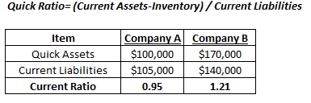
COMPANY A VS COMPANY B
Quick Ratio — Worked Example
Quick assets over current liabilities: Company A 0.95 vs Company B 1.21.
Financial Analysis for Small and Medium Enterprises · TGS-2026064860
© 2026 Tertiary Infotech Academy Pte Ltd
62

Slide 64
HOW MUCH RISK IN THE CAPITAL STRUCTURE?
Leverage Ratios
Debt Ratio
Total Debt / Total Assets
< 0.5 stable · > 0.5 stability issue
Debt-to-Equity
Total Liabilities / Shareholders' Equity
1.00 = half debt-financed; lower is safer
Times Interest Earned
EBIT / Interest Expense
Can earnings cover the interest bill?
Fixed Charge Coverage
(EBIT + Lease pmts) / (Interest + Lease pmts)
Adds lease obligations to the test
Debt Service Coverage
Operating Income / Total Debt Service
Principal + interest coverage
Financial Analysis for Small and Medium Enterprises · TGS-2026064860
© 2026 Tertiary Infotech Academy Pte Ltd
63

Slide 65
INTERPRETATION
Reading the Leverage Ratios
• Debt ratio measures the risk that assets cannot pay off debts — critical for long-term sustainability.
• Very low debt can also mean under-utilised financing and restricted growth.
• A rising debt-to-equity trend is a warning: more of the assets are financed by lenders.
• Higher times-interest-earned is favourable — the company earns enough to pay its interest.
Financial Analysis for Small and Medium Enterprises · TGS-2026064860
© 2026 Tertiary Infotech Academy Pte Ltd
64

Slide 66
HOW HARD ARE THE ASSETS WORKING?
Efficiency Ratios (1)
Asset Turnover
Net Sales / Average Total Assets
Revenue per dollar of assets
Inventory Turnover
COGS / Average Inventories
High = efficient; low = over-stocking
Receivables Turnover
Net Credit Sales / Average AR
How fast credit sales are collected
Payables Turnover
Net Purchases / Average AP
How quickly suppliers are repaid
Financial Analysis for Small and Medium Enterprises · TGS-2026064860
© 2026 Tertiary Infotech Academy Pte Ltd
65

Slide 67
TURNOVER & DAYS
Efficiency Ratios (2)
Fixed Asset Turnover
Net Revenue / Average Fixed Assets
Revenue per dollar of fixed assets
Working Capital Turnover
Revenue / Average Working Capital
Revenue per dollar of working capital
Average Collection Period
365 / Receivables Turnover
AR $40k on sales $400k → 36.5 days
Average Payment Period
365 / Payables Turnover
AP turnover 2 → 182.5 days to pay
Financial Analysis for Small and Medium Enterprises · TGS-2026064860
© 2026 Tertiary Infotech Academy Pte Ltd
66

Slide 68
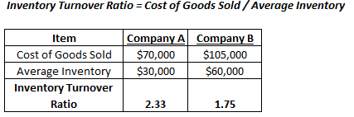
COMPANY A VS COMPANY B
Inventory Turnover — Worked Example
COGS over average inventory: Company A turns 2.33× vs Company B 1.75×.
Financial Analysis for Small and Medium Enterprises · TGS-2026064860
© 2026 Tertiary Infotech Academy Pte Ltd
67

Slide 69
IS THE BUSINESS EARNING ENOUGH?
Profitability Ratios
Gross Profit Margin
Gross Profit / Revenue
Production efficiency / pricing strategy
Operating Margin
Operating Income (EBIT) / Revenue
9% → $0.09 profit per $1 of sales
Net Profit Margin
Net Income / Net Sales
The most basic profitability measure
Return on Assets
Net Income / Average Total Assets
Cents earned per dollar of assets
Return on Capital Employed
Net Operating Profit / Capital Employed
Includes long-term finance
Return on Equity
Net Income / Average Shareholders' Equity
The owners' return on new investment
Financial Analysis for Small and Medium Enterprises · TGS-2026064860
© 2026 Tertiary Infotech Academy Pte Ltd
68

Slide 70
INTERPRETATION
Reading the Profitability Ratios
• Higher ratios are more favourable — they reflect the ability to generate earnings.
• Compare only within the same industry: asset-heavy industries naturally show lower ROA.
• A rising ROA / ROE trend means profitability is improving; a falling trend means it is deteriorating.
• ROE can be manipulated with debt — never rely on ROE alone for investment decisions.
Financial Analysis for Small and Medium Enterprises · TGS-2026064860
© 2026 Tertiary Infotech Academy Pte Ltd
69

Slide 71
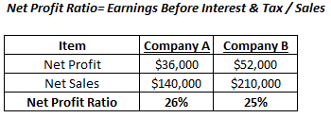
COMPANY A VS COMPANY B
Net Profit Ratio — Worked Example
Net profit over net sales: Company A 26% vs Company B 25%.
Financial Analysis for Small and Medium Enterprises · TGS-2026064860
© 2026 Tertiary Infotech Academy Pte Ltd
70

Slide 72
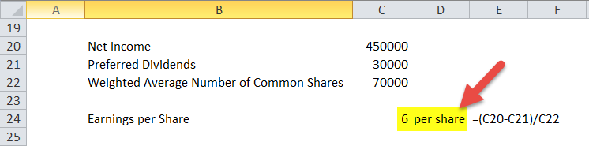
PER-SHARE PROFITABILITY
Earnings Per Share (EPS)
• EPS = (Net Income − Preferred Dividends) / Weighted Average Common Shares
• Standardises earnings by the number of shares outstanding.
• Not comparable alone — different companies have different share counts.
• Feeds the price-to-earnings (P/E) ratio used by investors.
Financial Analysis for Small and Medium Enterprises · TGS-2026064860
© 2026 Tertiary Infotech Academy Pte Ltd
71

Slide 73
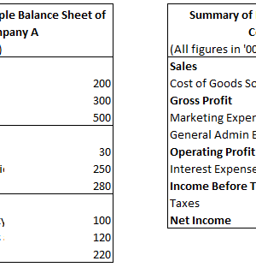
PUTTING IT TOGETHER
Measuring Profitability — Sample Company
• Gross Margin: 37.50%
• Operating Margin: 26.67%
• Net Profit Margin: 16.67%
• Return on Equity: 9.09%
• Return on Assets: 4%
• Derived from the sample balance sheet and income statement shown.
Financial Analysis for Small and Medium Enterprises · TGS-2026064860
© 2026 Tertiary Infotech Academy Pte Ltd
72

Slide 74
K4 · EQUITY CHANGES STATEMENT
Statement of Changes in Equity
What it is
Also called the statement of retained earnings — reconciles opening to closing equity.
The equation
Beginning Equity + Net Income − Dividends ± Other changes = Ending Equity.
1
2
Components
Opening balance · policy changes · prior-period corrections · restated balance.
More components
Changes in share capital · dividends · income/loss · revaluation reserve · other gains and losses.
3
4
Financial Analysis for Small and Medium Enterprises · TGS-2026064860
© 2026 Tertiary Infotech Academy Pte Ltd
73

Slide 75
ONE-PAGE CHEAT SHEET
Summary of All Ratios
Liquidity & Leverage
Efficiency & Profitability
• Liquidity
– Current = CA / CL
– Acid test = (CA − Inventories) / CL
– Cash = Cash & equivalents / CL
– Operating CF = OCF / CL
• Leverage
– Debt = Total liabilities / Total assets
– Debt-to-equity = Total liabilities / Equity
– Debt service coverage = Op. income / Debt service
• Efficiency
– Asset turnover = Net sales / Avg total assets
– Inventory turnover = COGS / Avg inventory
– Receivables turnover = Net sales / Avg AR
– Payables turnover = Net purchases / Avg AP
• Profitability
– Gross margin = Gross profit / Net sales
– Operating margin = EBIT / Net sales · Net margin = NI / Net sales
– ROE = NI / Equity · ROA = NI / Total assets
Financial Analysis for Small and Medium Enterprises · TGS-2026064860
© 2026 Tertiary Infotech Academy Pte Ltd
74

Slide 76
TOPIC 02 · HANDS-ON
Ratio Analysis of Two Companies
ACTIVITY 2
Orchid Logistics Pte Ltd (Company X) and Marina Retail Group Pte Ltd (Company Y) are two fictitious SMEs. From their FY2025 balance sheets and income statements, compute the liquidity, profitability, turnover and solvency ratios for both companies and give a one-line verdict per ratio family on which company performs better.
You'll produce
A completed ratio-analysis worksheet comparing Company X and Company Y across four ratio families, with a one-line verdict per ratio.
Tools: Microsoft Excel · data workbook FA-Activity-02-Ratio-Analysis.xlsx in activities/activity02
All files: activities/activity02/ · Detailed step-by-step: see this activity in the Learner Guide.
Financial Analysis for Small and Medium Enterprises · TGS-2026064860
© 2026 Tertiary Infotech Academy Pte Ltd
75

Slide 77
TOPIC 02 · HANDS-ON
Trend Analysis over Four Years
ACTIVITY 3
Sunrise F&B Holdings Pte Ltd is a fictitious cafe-chain SME. From four years (FY2018–FY2021) of balance sheets and income statements, compute year-on-year growth for every line, derive the key ratios for each year, and present your observations on where the business is heading.
You'll produce
A completed trend-analysis template: YoY growth for every balance-sheet and income-statement line plus a four-year ratio table with your observations.
Tools: Microsoft Excel · data workbook FA-Activity-03-Trend-Analysis.xlsx in activities/activity03
All files: activities/activity03/ · Detailed step-by-step: see this activity in the Learner Guide.
Financial Analysis for Small and Medium Enterprises · TGS-2026064860
© 2026 Tertiary Infotech Academy Pte Ltd
76

Slide 78
TOPIC RECAP
Recap — Analysing Financial Ratios
• Liquidity, leverage, efficiency and profitability — the four ratio families.
• Every ratio needs a benchmark: industry, competitor or the company's own trend.
• The statement of changes in equity reconciles opening to closing equity.
• You compared two companies ratio-by-ratio and ran a four-year trend analysis.
Financial Analysis for Small and Medium Enterprises · TGS-2026064860
© 2026 Tertiary Infotech Academy Pte Ltd
77

Slide 79
03
TOPIC 03
Planning & Budgeting using Financial Statements
Analyse Financial Statements · Financial Planning · Capital Budgeting
Financial Analysis for Small and Medium Enterprises · TGS-2026064860
© 2026 Tertiary Infotech Academy Pte Ltd
78

Slide 80
TSC K5 · A2
Key Concepts — Planning & Budgeting using Financial Statements
Budgeting
Baseline, incremental, zero-based and hybrid budgets — planning income vs spending.
Capital budgeting
Payback, discounted payback, NPV, PI and IRR — evaluating long-term investments.
1
2
Time value of money
PV = FV / (1+i)^n — a dollar today is worth more than a dollar tomorrow.
Forecast & variance
Budget vs actual vs forecast — favourable and adverse variances, thresholds.
3
4
Financial health
Read the balance sheet, income and cash flow statements together, then ratio-check.
Analysis methods
Ratio, horizontal (trend) and vertical analysis, plus industry benchmarking (A2).
5
6
Financial Analysis for Small and Medium Enterprises · TGS-2026064860
© 2026 Tertiary Infotech Academy Pte Ltd
79

Slide 81
BUDGET
Budgeting is balancing your expenses with your income —
by creating a plan to spend your money. To balance a budget you have two levers: increase income or decrease spending.
Financial Analysis for Small and Medium Enterprises · TGS-2026064860
© 2026 Tertiary Infotech Academy Pte Ltd
80

Slide 82
EXPENSES · INCOME
Key Components of a Budget
Fixed expenses
Stay the same month to month — e.g. rent payments.
Flexible expenses
Change month to month — e.g. utilities.
1
2
Capital vs operating
Capital expenses buy long-term assets; operating expenses run the business.
Total income
Income from operations and other sources — investments, rentals and more.
3
4
Disposable income
What is left after taxes are subtracted.
Variance
The gap between the plan and the actual outcome.
5
6
Financial Analysis for Small and Medium Enterprises · TGS-2026064860
© 2026 Tertiary Infotech Academy Pte Ltd
81

Slide 83
FOUR APPROACHES
Broad Budgeting Methods
Baseline budget
Begins with a previous plan as the baseline.
Incremental budget
A % or $ increment on the previous baseline.
1
2
Zero-based budget
Starts fresh, like a brand-new plan.
Hybrid budget
A combination of any of the above.
3
4
Financial Analysis for Small and Medium Enterprises · TGS-2026064860
© 2026 Tertiary Infotech Academy Pte Ltd
82

Slide 84
TERMS YOU WILL MEET
Budgeting Vocabulary
Fiscal year · budget communications
Budget targets · budget guidelines
1
2
Annual plan · budget review
Board review · approved plan
3
4
Forecast · actual
Variance
5
6
Financial Analysis for Small and Medium Enterprises · TGS-2026064860
© 2026 Tertiary Infotech Academy Pte Ltd
83

Slide 85
WHY BUDGET
Budgeting — Objectives
• Provides clear structure, guidance and a basis for the action plan.
• Predicts expected cash flows and allocates resources to the right activities.
• Lets management prioritise projects and model scenarios — worst, median, best and custom cases.
• Measures actual performance against the approved plan and analyses the causes of variances.
• Ensures control over spending and mandates responsibility and accountability.
Financial Analysis for Small and Medium Enterprises · TGS-2026064860
© 2026 Tertiary Infotech Academy Pte Ltd
84

Slide 86
MAKING BUDGETS WORK
Budgeting — Advantages & Success Factors
Advantages
Success factors
• Advantages
– Planning orientation and profitability review
– Assumptions review and performance evaluation
– Funding planning and cash allocation
– Bottleneck analysis
• Success factors
– Management support and employee involvement
– Clear organisational goals and responsibility accounting
– Sound accounting system and organisational structure
– Flexibility and communication of results
Financial Analysis for Small and Medium Enterprises · TGS-2026064860
© 2026 Tertiary Infotech Academy Pte Ltd
85

Slide 87
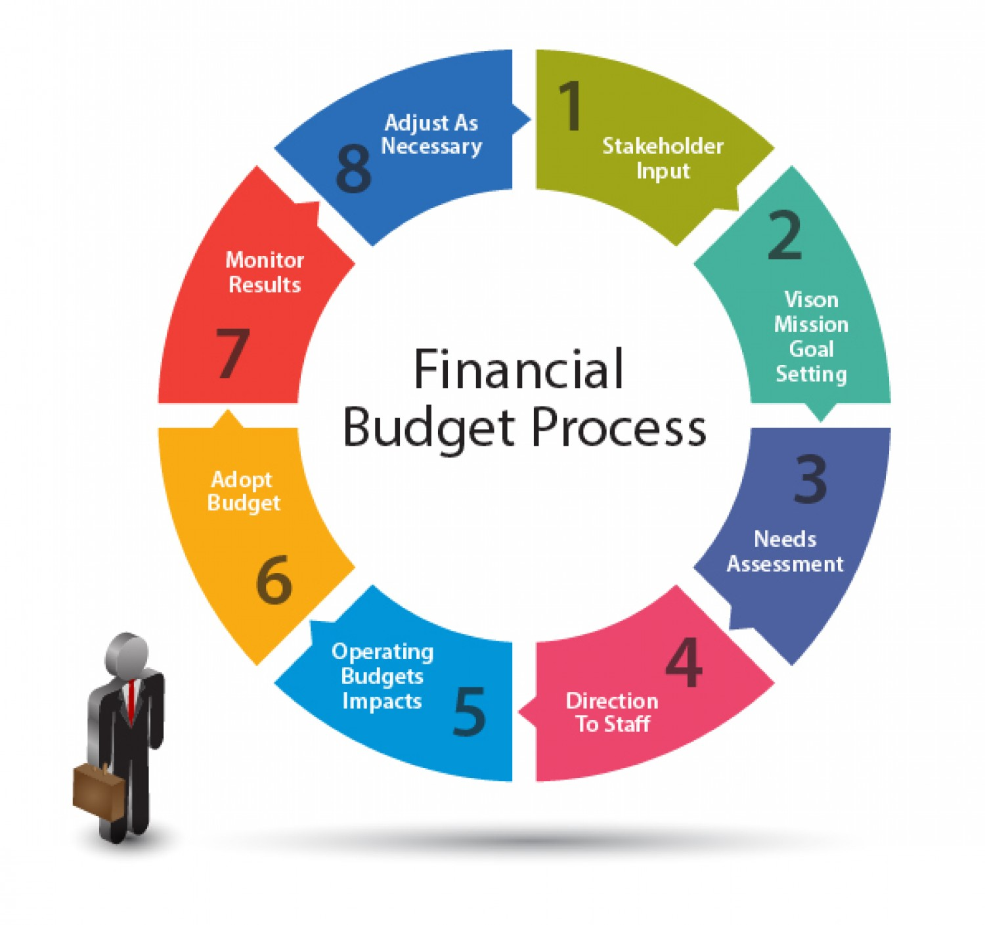
FROM STAKEHOLDER INPUT TO MONITORING
The Budgeting Process
Stakeholder input → goal setting → needs assessment → direction → operating budgets → adoption → monitoring → adjustment.
Financial Analysis for Small and Medium Enterprises · TGS-2026064860
© 2026 Tertiary Infotech Academy Pte Ltd
86

Slide 88
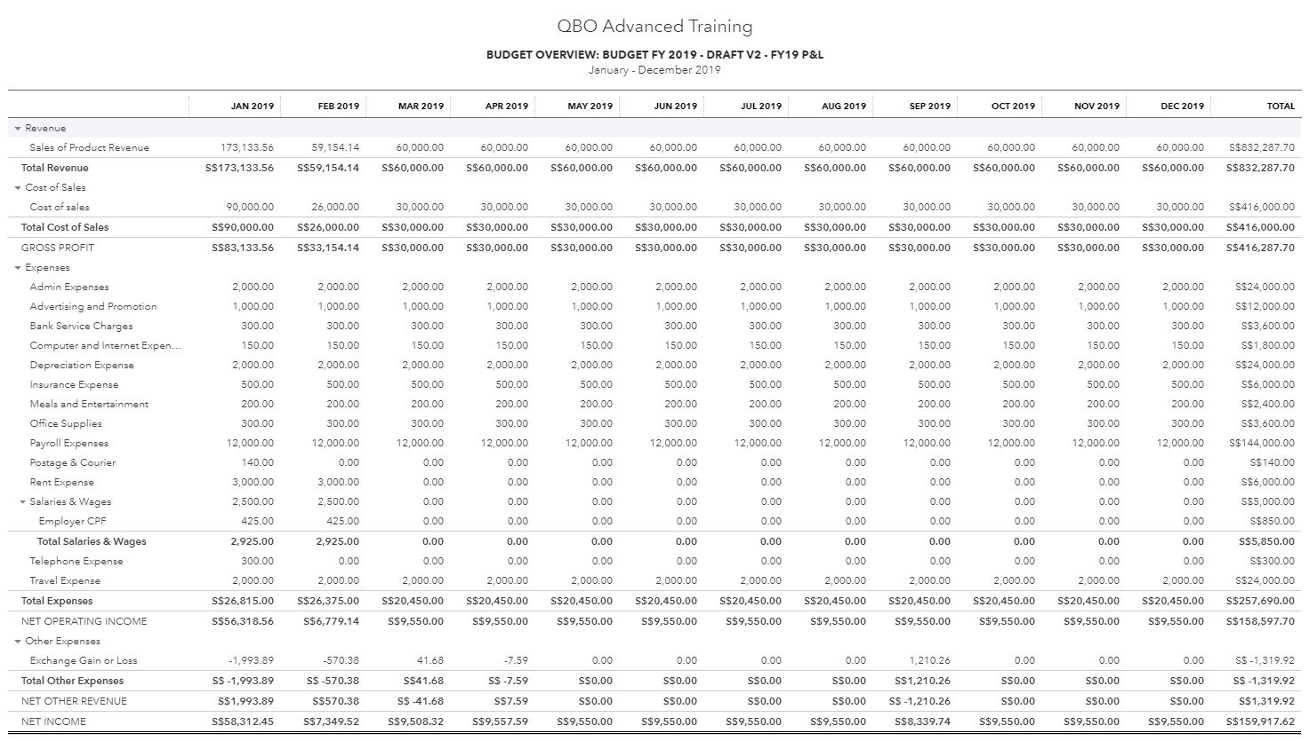
BUDGET OVERVIEW · FY PLAN
Sample Budget Report
A monthly phased budget: revenue and expense lines with totals for the fiscal year.
Financial Analysis for Small and Medium Enterprises · TGS-2026064860
© 2026 Tertiary Infotech Academy Pte Ltd
87

Slide 89
INVESTING FOR THE LONG TERM
Capital Budgeting
Purpose
Planning for long-term investments in projects and assets.
Cash, not profit
Focus on cash inflows and outflows, not accounting revenue and expenses.
1
2
Time value of money
Adjust future cash flows to today's dollars before comparing.
Decision methods
Payback · discounted payback · NPV · profitability index · IRR.
3
4
Financial Analysis for Small and Medium Enterprises · TGS-2026064860
© 2026 Tertiary Infotech Academy Pte Ltd
88

Slide 90
A DOLLAR TODAY BEATS A DOLLAR TOMORROW
Time Value of Money
Present Value
PV = FV / (1 + i)^n
$10,000 in 2 yrs @5% → $9,070.30 today
Future Value
FV = PV × (1 + i)^n
$10,000 today @5% → $11,025 in 2 yrs
Components
PV · FV · N periods · Interest i · Payment PMT
Opportunity cost: interest or inflation
Financial Analysis for Small and Medium Enterprises · TGS-2026064860
© 2026 Tertiary Infotech Academy Pte Ltd
89

Slide 91
SIX STEPS
Capital Budgeting Process
1
2
3
4
5
6
▶
▶
▶
▶
▶
Identify long-term goals
Identify investment proposals
Estimate & analyse the cash flows
Analyse financial feasibility
Choose & implement projects
Monitor the projects
Financial Analysis for Small and Medium Enterprises · TGS-2026064860
© 2026 Tertiary Infotech Academy Pte Ltd
90

Slide 92
FIVE DECISION TOOLS
Capital Budgeting Methods
Payback Period
Outlay / Annual cash inflow
$2,000 / $375 = 5.33 years
Discounted Payback
Cumulative discounted CF ≥ outlay
Same project at 10% → ≈ 8 years
Net Present Value
Σ PV(inflows) − Outlay
Accept if NPV > 0
Profitability Index
PV(inflows) / PV(outflows)
Accept if PI > 1
Internal Rate of Return
Rate where NPV = 0
Accept if IRR > threshold rate
Financial Analysis for Small and Medium Enterprises · TGS-2026064860
© 2026 Tertiary Infotech Academy Pte Ltd
91

Slide 93
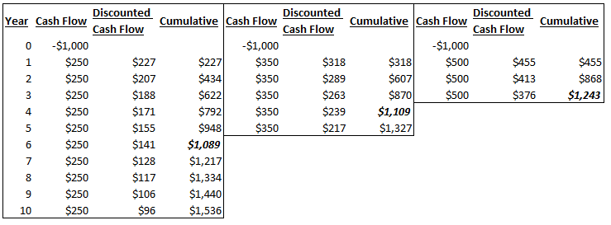
DISCOUNTING THE CASH FLOWS
Discounted Payback — Worked Example
Each future inflow is discounted before accumulating — payback arrives later than the simple method.
Financial Analysis for Small and Medium Enterprises · TGS-2026064860
© 2026 Tertiary Infotech Academy Pte Ltd
92

Slide 94
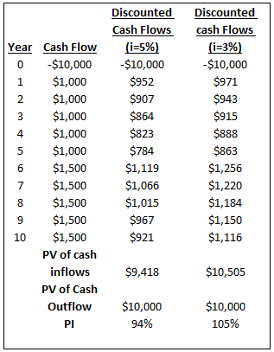
PI > 1 → ACCEPT
Profitability Index — Worked Example
• Discount every inflow at the required return.
• PV of inflows $2,304 vs PV of outflows $2,000.
• PI = 2,304 / 2,000 = 1.15 → accept the project.
• NPV = $304 — the same accept signal.
Financial Analysis for Small and Medium Enterprises · TGS-2026064860
© 2026 Tertiary Infotech Academy Pte Ltd
93

Slide 95
TOPIC 03 · HANDS-ON
Payback Period & Discounted Payback Period
ACTIVITY 4
Havenwood Trading is evaluating a refrigerated delivery van: S$2,000k outlay in Year 0, saving S$375k per year for 10 years versus outsourced cold-chain delivery. Compute the simple payback period, then discount each cash flow at the 10% required return to find the discounted payback.
You'll produce
A payback worksheet showing cumulative cash flow per year, the simple payback point (5.33 years) and the discounted payback point (≈8 years).
Tools: Microsoft Excel · data workbook FA-Activity-04-Payback-Period.xlsx in activities/activity04
All files: activities/activity04/ · Detailed step-by-step: see this activity in the Learner Guide.
Financial Analysis for Small and Medium Enterprises · TGS-2026064860
© 2026 Tertiary Infotech Academy Pte Ltd
94

Slide 96
TOPIC 03 · HANDS-ON
Net Present Value & Profitability Index
ACTIVITY 5
Using the same delivery-van proposal (S$2,000k outlay, S$375k/year for 10 years, 10% required return), compute the Net Present Value and the Profitability Index, and make the accept/reject recommendation to management.
You'll produce
An NPV/PI worksheet: PV of each inflow, NPV ≈ S$304k, PI ≈ 1.15, and a reasoned accept decision.
Tools: Microsoft Excel · data workbook FA-Activity-05-NPV-PI.xlsx in activities/activity05
All files: activities/activity05/ · Detailed step-by-step: see this activity in the Learner Guide.
Financial Analysis for Small and Medium Enterprises · TGS-2026064860
© 2026 Tertiary Infotech Academy Pte Ltd
95

Slide 97
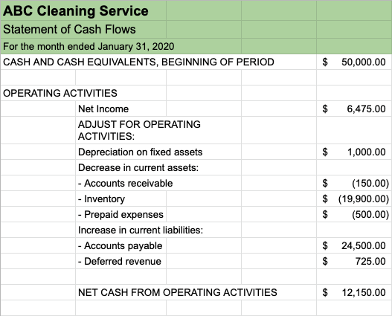
MONTHLY CASH DISCIPLINE
Cash Flow Analysis & Management
• Track the monthly statement of cash flows.
• Improve cash flow: invoice promptly and chase receivables.
• Negotiate supplier terms; manage inventory tightly.
• Time capital spending; keep a cash buffer.
Financial Analysis for Small and Medium Enterprises · TGS-2026064860
© 2026 Tertiary Infotech Academy Pte Ltd
96

Slide 98
FORECASTING THE STATEMENTS
Pro Forma (Projected) Financial Statements
Purpose
Plan ahead and compare actual vs predicted performance.
What is projected
The income statement and the balance sheet.
1
2
Cash flow
The projected cash flow is derived from the other two statements.
Forecasting cash
Estimate monthly sales → predict receipt of payments → estimate costs.
3
4
Financial Analysis for Small and Medium Enterprises · TGS-2026064860
© 2026 Tertiary Infotech Academy Pte Ltd
97

Slide 99
THE CONTROL LOOP
Budget, Actual, Variance, Forecast
• Budget: planned sales of $500,000. Actual: sales of $400,000.
• Variance: −$100,000 — or −20% of budget ($100,000 / $500,000).
• Both the dollar and percentage variance appear on the Budget-to-Actual report.
• Forecast: the projection of future periods from historical data, updated at regular intervals.
Financial Analysis for Small and Medium Enterprises · TGS-2026064860
© 2026 Tertiary Infotech Academy Pte Ltd
98

Slide 100
PLAN VS PREDICTION
Budget vs Forecast
Budget
Forecast
• Budget
– A financial plan expressed in quantitative terms, prepared in advance
– The financial expression of a business target
– Sets targets · updated annually
– Variance analysis: yes
• Forecast
– Estimation of future trends from past and present data
– A prediction of upcoming events and trends
– No targets · updated at regular intervals
– Variance analysis: no
Financial Analysis for Small and Medium Enterprises · TGS-2026064860
© 2026 Tertiary Infotech Academy Pte Ltd
99

Slide 101
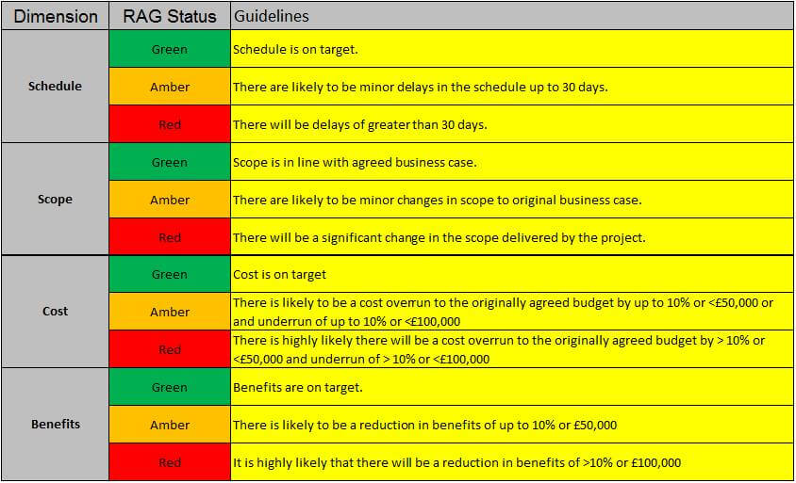
ADVERSE VS FAVOURABLE
Types of Variances
• Adverse variance: actual income below budget, or spending above budget — a deficit.
• Favourable variance: actual income above budget, or spending below budget — a surplus.
• Manage over/underspend with clear-cut thresholds in dollars or percent.
• RAG-status thresholds trigger review at defined limits.
Financial Analysis for Small and Medium Enterprises · TGS-2026064860
© 2026 Tertiary Infotech Academy Pte Ltd
100

Slide 102
RISK PROFILING
Business & Financial Risk
High-risk company
Operates in a high-risk industry AND faces a risk of financial failure.
High-risk factors
Financial risk (banks, merchant accounts) · compliance · safety and statutory law.
1
2
Consequences
High-risk borrowers pay higher loan rates and larger down payments.
Risk types
Strategic · compliance · financial · operational · reputational risks.
3
4
Examples
Agriculture, construction and mining industries.
Low-risk company
Stable industry and sound finances — the reverse conditions.
5
6
Financial Analysis for Small and Medium Enterprises · TGS-2026064860
© 2026 Tertiary Infotech Academy Pte Ltd
101

Slide 103
THREE-STATEMENT REVIEW
Determine the Financial Health of a Company
Balance sheet
Income statement
Cash flow statement
• Debt relative to equity
• Short-term liquidity
• Tangible vs financial assets
• Collection & repayment cycles
• Time to sell inventory
• Revenue growth by period
• Gross profit margin
• Net profit % of revenue
• Interest cover on debt
• Payout vs reinvestment
• Liquidity situation
• Sources of cash
• Free cash flow generated
• Overall cash increase or decrease
Financial Analysis for Small and Medium Enterprises · TGS-2026064860
© 2026 Tertiary Infotech Academy Pte Ltd
102

Slide 104
RATIO CHECKLIST
…then Ratio-Check the Health
Margins
Gross profit margin and net profit margin on revenue.
Coverage
Ability to meet obligations — debt and interest payments.
1
2
Liquidity
Current ratio and quick ratio for obligations under one year.
Leverage
Debt-to-equity: the financing mix.
3
4
Efficiency
Inventory turnover and total asset turnover.
Returns
ROE and ROA: profit from equity and from assets.
5
6
Financial Analysis for Small and Medium Enterprises · TGS-2026064860
© 2026 Tertiary Infotech Academy Pte Ltd
103

Slide 105
WHAT INVESTORS EXAMINE
Financial Analysis for Investment Suitability
Revenues
Quantity, quality and timing · growth (ignore one-offs) · concentration · revenue per employee.
Profits
Gross, operating and net profit margins.
1
2
Operational efficiency
Receivables turnover and inventory turnover.
Market data
P/E ratio · price-to-book · PEG ratio.
3
4
Capital & solvency
Return on equity · debt-to-equity · liquidity.
DuPont index
Net Profit Margin × Asset Turnover × Equity Multiplier = ROE decomposed.
5
6
Financial Analysis for Small and Medium Enterprises · TGS-2026064860
© 2026 Tertiary Infotech Academy Pte Ltd
104

Slide 106
SECTOR-SPECIFIC RATIOS
Industry Ratios — Banking & Insurance
Banking
Insurance
• Banking
– Net interest margin = (Interest income − expense) / Total assets
– Efficiency ratio = Non-interest expense / Revenue
– Liquidity coverage ratio · leverage ratio · CET1 ratio
• Insurance
– Persistency = paying policyholders / active policyholders
– Solvency = available / required solvency margin
– Combined ratio · incurred claims ratio · claim settlement ratio
Financial Analysis for Small and Medium Enterprises · TGS-2026064860
© 2026 Tertiary Infotech Academy Pte Ltd
105

Slide 107
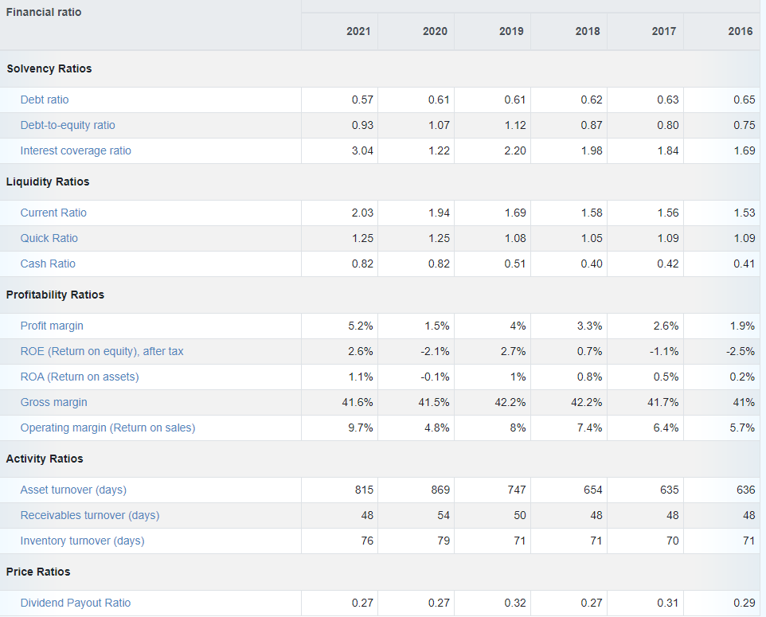
AGAINST INDUSTRY AVERAGES
Benchmarking Financial Performance
Trend of US sectoral averages — compare your ratios against the sector, not in isolation.
Financial Analysis for Small and Medium Enterprises · TGS-2026064860
© 2026 Tertiary Infotech Academy Pte Ltd
106

Slide 108
THREE LENSES
Financial Statement Analysis — Methods
Ratio analysis
Horizontal (trend)
Vertical analysis
• Generate the ratios
• Compare against benchmarks
• Track the ratio trend over time
• Compare across periods
• % change of the same line item
• Spot growth and deterioration
• Every line as % of a base figure
• IS lines as % of gross sales
• BS lines as % of total assets
Financial Analysis for Small and Medium Enterprises · TGS-2026064860
© 2026 Tertiary Infotech Academy Pte Ltd
107

Slide 109
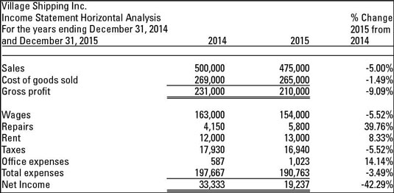
% CHANGE ACROSS PERIODS
Horizontal Analysis — Example
Income statement lines for two years with the percentage change of each item.
Financial Analysis for Small and Medium Enterprises · TGS-2026064860
© 2026 Tertiary Infotech Academy Pte Ltd
108

Slide 110
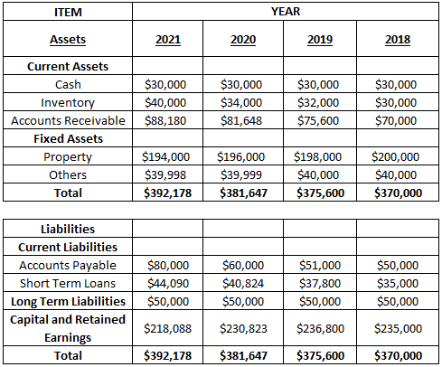
FOUR-YEAR BALANCE SHEET
Horizontal Analysis — Case Study
Balance-sheet items tracked across 2018–2021 — the raw material for trend analysis.
Financial Analysis for Small and Medium Enterprises · TGS-2026064860
© 2026 Tertiary Infotech Academy Pte Ltd
109

Slide 111
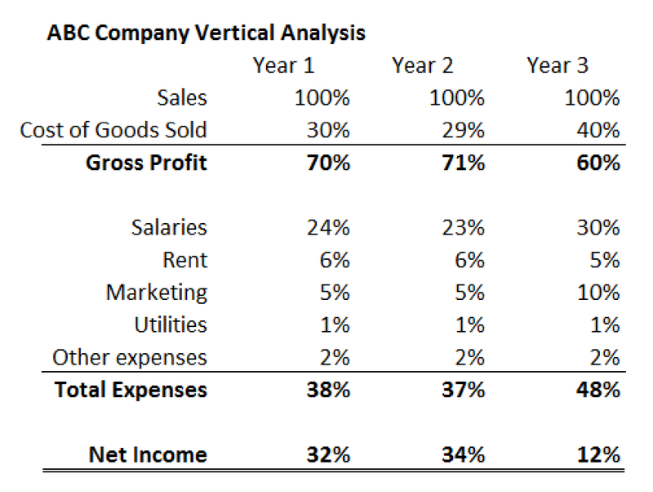
EVERY LINE AS % OF THE BASE
Vertical Analysis — Example
Income-statement items expressed as a percentage of sales for three years.
Financial Analysis for Small and Medium Enterprises · TGS-2026064860
© 2026 Tertiary Infotech Academy Pte Ltd
110

Slide 112
TOPIC 03 · HANDS-ON
Solvency & Financial Risk Analysis
ACTIVITY 6
Return to Orchid Logistics (Company X) and Marina Retail Group (Company Y). Using their balance sheets and income statements, compare the two companies' solvency risk — debt-to-equity, financial leverage and interest coverage — and conclude which is the riskier borrower.
You'll produce
A solvency comparison table (D/E, leverage, interest coverage) for X and Y with a reasoned risk verdict.
Tools: Microsoft Excel · data workbook FA-Activity-06-Solvency-Analysis.xlsx in activities/activity06
All files: activities/activity06/ · Detailed step-by-step: see this activity in the Learner Guide.
Financial Analysis for Small and Medium Enterprises · TGS-2026064860
© 2026 Tertiary Infotech Academy Pte Ltd
111

Slide 113
TOPIC RECAP
Recap — Planning & Budgeting using Financial Statements
• Budgets plan the spending; forecasts predict the outcome; variances close the loop.
• Capital budgeting decisions: payback, discounted payback, NPV, PI and IRR.
• Financial health = balance sheet + income statement + cash flow, then ratio-check.
• Ratio, horizontal and vertical analysis — plus benchmarking — complete the toolkit.
• You evaluated an investment project and compared two companies' solvency risk.
Financial Analysis for Small and Medium Enterprises · TGS-2026064860
© 2026 Tertiary Infotech Academy Pte Ltd
112

Slide 114
WRAP-UP
Course Summary & Next Steps
Financial Analysis for Small and Medium Enterprises · TGS-2026064860
© 2026 Tertiary Infotech Academy Pte Ltd
113

Slide 115
LEARNING OUTCOMES
What You Achieved
Financial statements (LO1)
Read and prepared balance sheets, income statements and cash flow statements.
1
Ratio analysis (LO2)
Evaluated performance with liquidity, leverage, efficiency and profitability ratios and their trends.
2
Planning & budgeting (LO3)
Built budgets, evaluated investments (payback, NPV, PI) and assessed financial health and risk.
3
Financial Analysis for Small and Medium Enterprises · TGS-2026064860
© 2026 Tertiary Infotech Academy Pte Ltd
114

Slide 116
KEEP LEARNING
Recommended Courses
• WSQ - Quickbooks Accounting System for Small and Medium Enterprises
• WSQ - Unlocking the Power of Accounting and Tax Systems for SMEs
• WSQ - Statistical Data Analysis with Excel for Beginners
• WSQ - Budgeting for Small and Medium Enterprises
• WSQ - Software Automation with Excel VBA Programming
Financial Analysis for Small and Medium Enterprises · TGS-2026064860
© 2026 Tertiary Infotech Academy Pte Ltd
115

Slide 117
WE'RE HERE TO HELP
Support
• If you have any enquiries during and after the class, contact us:
• Email: enquiry@tertiaryinfotech.com
• Tel: +65 6100 0613
• Website: www.tertiarycourses.com.sg
Financial Analysis for Small and Medium Enterprises · TGS-2026064860
© 2026 Tertiary Infotech Academy Pte Ltd
116

Slide 118
WRAP-UP
Assessment
• Written Assessment (WA) — Short-Answer Questions (SAQ), 1 hour, open book.
• Practical Performance (PP) — financial-analysis tasks on real statements, 1 hour, open book.
• Open book: slides, Learner Guide and approved materials only.
• Remember to take the Assessment digital attendance (TRAQOM).
• Submit your completed answers on the LMS at https://lms-tms.tertiaryinfotech.com/.
Financial Analysis for Small and Medium Enterprises · TGS-2026064860
© 2026 Tertiary Infotech Academy Pte Ltd
117

Slide 119
ON ASSESSMENT DAY
Assessment Flow
1
2
3
4
5
▶
▶
▶
▶
TRAQOM survey — scan the QR code on the LMS
Assessment digital attendance — scan the SSG QR
Sit WA (SAQ) then PP — open book
Submit your answers on the LMS
Sign the Assessment Summary Record
Financial Analysis for Small and Medium Enterprises · TGS-2026064860
© 2026 Tertiary Infotech Academy Pte Ltd
118

Slide 120
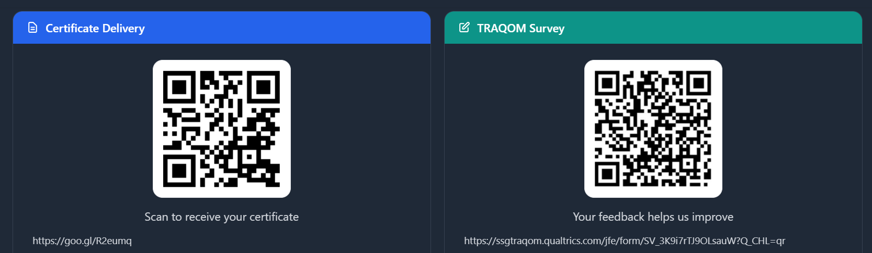
https://lms-tms.tertiaryinfotech.com/
Cert & TRAQOM Survey (Mandatory)
Scan the QR codes to receive your certificate and complete the TRAQOM survey.
Financial Analysis for Small and Medium Enterprises · TGS-2026064860
© 2026 Tertiary Infotech Academy Pte Ltd
119

Slide 121
TRAQOM · SSG DIGITAL ATTENDANCE
Digital Attendance (Mandatory)
• It is mandatory to take the AM, PM and Assessment digital attendance for WSQ-funded courses.
• The trainer or administrator will show you the digital attendance QR code generated from the SSG portal.
• Scan the QR code with your mobile phone camera and submit your attendance.
• A minimum of 75% attendance is required to be eligible for assessment and funding.
Financial Analysis for Small and Medium Enterprises · TGS-2026064860
© 2026 Tertiary Infotech Academy Pte Ltd
120

Slide 122
SEE YOU IN THE NEXT COURSE
Thank You!
You can now read, analyse and plan with financial statements — and put them to work for your SME.
Financial Analysis for Small and Medium Enterprises · TGS-2026064860
© 2026 Tertiary Infotech Academy Pte Ltd
121

